Slide 1
An Investigation of Kaczmarz Algorithm Variations and Preconditioning
Liam Kelz, Rockwell P. Jackson, Jake Truong-Jones, Vijval Rajan
Advised By: Rodrigo B. Platte

Slide 2
Solving a linear system of equations
Fields and examples of what they solve linear systems for
Physics - Schrodinger’s equation
Engineering - Circuit Design
Computer Science - Graphics, Machine Learning, Computer Vision
Medicine - Reconstruction of image using data from a scan (CAT, MRI, PET)
Geophysics - Construction of images of Earth’s interior from seismic data

Slide 3
History of Kaczmarz
The classical Kaczmarz method was proposed in 1937 by Stefan Kaczmarz
Translated to English in 1993
Variations have gained popularity in recent years because they use partial information in each iteration and are suitable for large data problems.
Strohmer and Vershynin proved that randomized Kaczmarz converges exponentially with random row selection in 2009
Randomized Block Kaczmarz was introduced by D. Needell in 2010

Slide 4
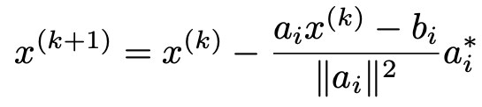
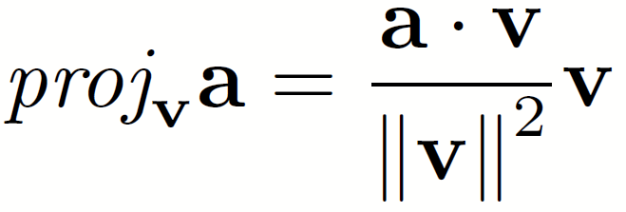
The Original Kaczmarz Algorithm
Projection formula

Slide 5
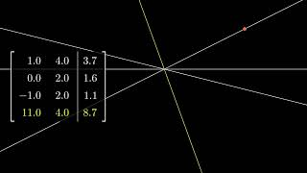

Slide 6
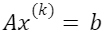
Row Selection Methods
Random Row Selection: Choose a random block of rows from the system -Is inexpensive to select rows
Targeted Row Selection: Choose a block of rows with the highest residuals -Residual: Magnitude of , is current approximation -Allows algorithm to bias towards parts of the system that are causing the most error in the current approximation -Residual Calculation is expensive
Random-Targeted Row Selection: Choose a random block of rows from the system and then pick the highest residuals from that subset -Middle ground between other two methods

Slide 7
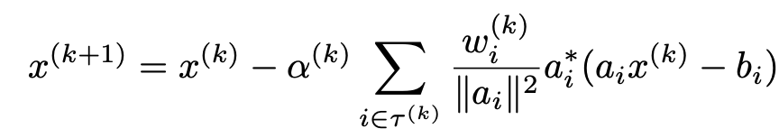
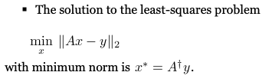
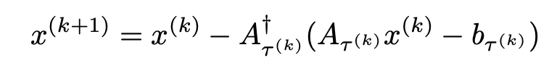
Iteration Methods
Single row Kaczmarz:
Averaged Iteration: Calculates update by taking the average of the projection onto each row
-Choose alpha to minimize residual between steps
Projected Iteration: Calculates update by taking the projection onto the solution of the selected block of rows

Slide 8
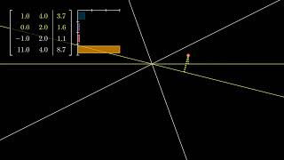
Random Row Selection

Slide 9
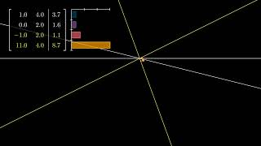
Targeted Row Selection

Slide 10
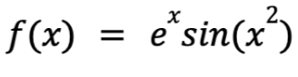
Experiment
Each combination was used to do polynomial interpolation on several functions. Graphs are for
Average CPU Time and Iterations taken vs. Degree (matrix size)
Block size constant, initial block size was twice runoff block size for RT
Other constants: Interpolation Domain [0,1], Chebyshev matrix was used, relative tolerance 10^(-10), max iterations 40000

Slide 11
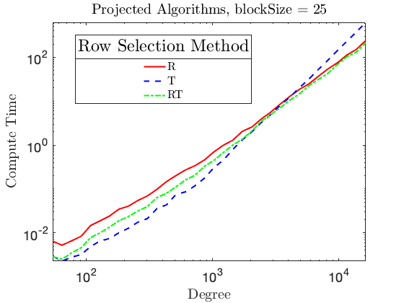
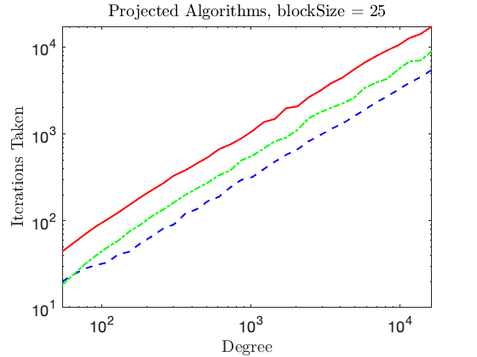
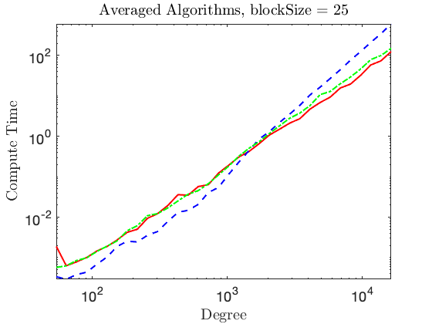
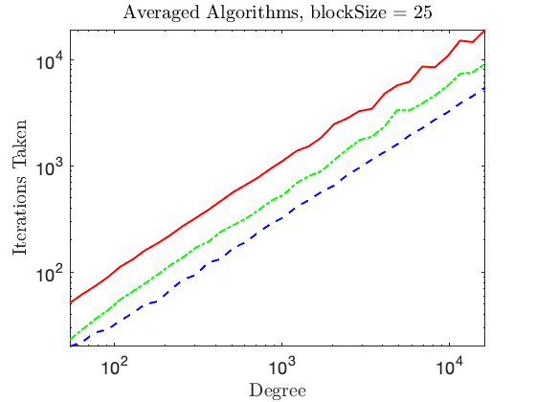

Slide 12
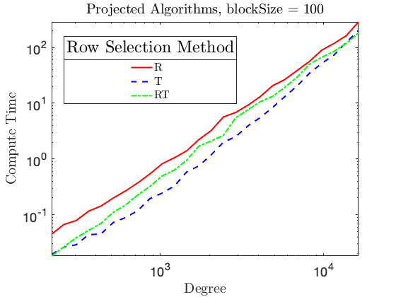
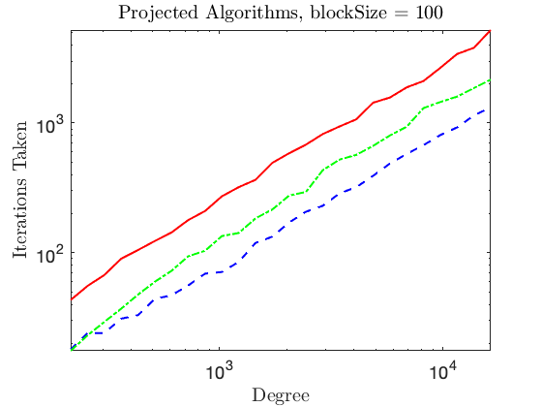
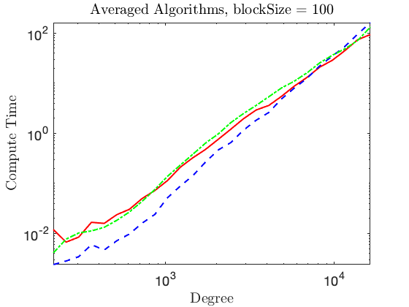
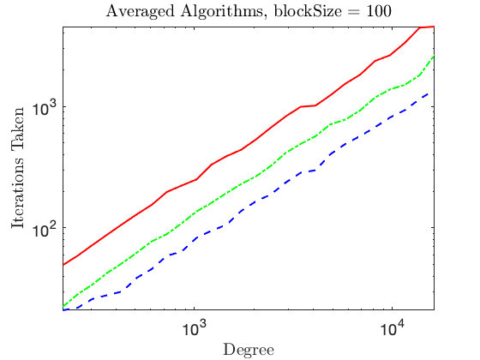

Slide 13
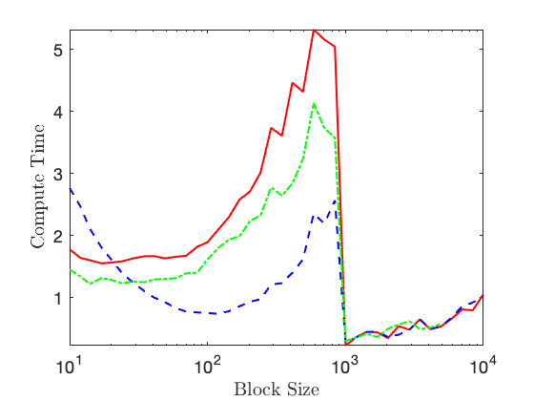
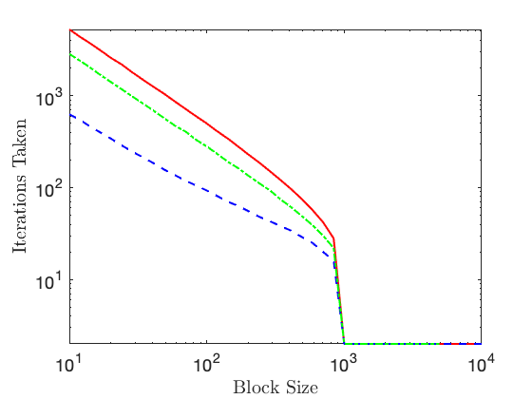
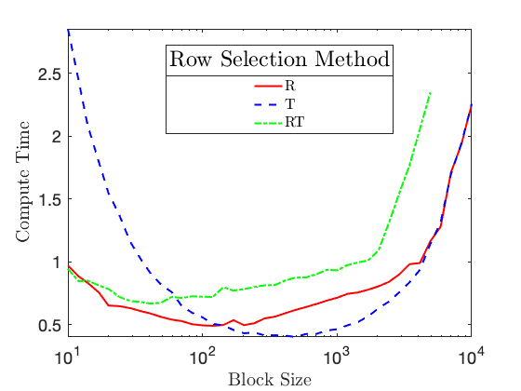
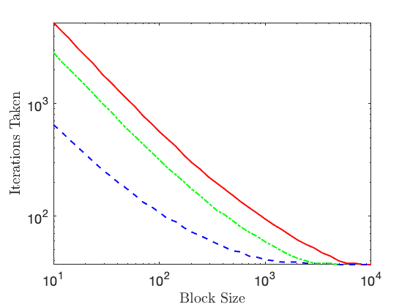
Dependence on Block Size
Projected Block Kaczmarz
10000 x 1000 Random System Consistent (normal distribution)
Averaged Block Kaczmarz

Slide 14
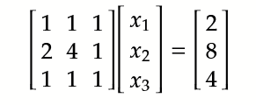
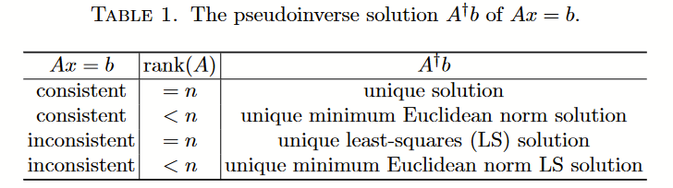
Inconsistent Systems
Doesn’t have any solutions
Can’t be solved by normal kaczmarz
Best you can do is the unique least-squares solution

Slide 15
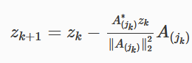
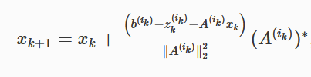
Extended Kaczmarz
Adds another variable Z
Z uses column selection instead of rows
Z “absorbs” the least squares error
Instead of solving 1 inconsistent system
you now just solve 2 consistent systems
A’z= 0 and Ax=b-z
Row and Column methods can use other styles! Randomized, Targeted, etc.

Slide 16
Separate the Systems
The z calculation is unaffected by x calculation.
Many calculations wasted since z usually is faster than x
So we can calculate z separately before calculating the x
This gives a significant decrease in calculation time and iterations
The effect is most notable for tall rectangular matrices, which is what Kaczmarz is best at.

Slide 17
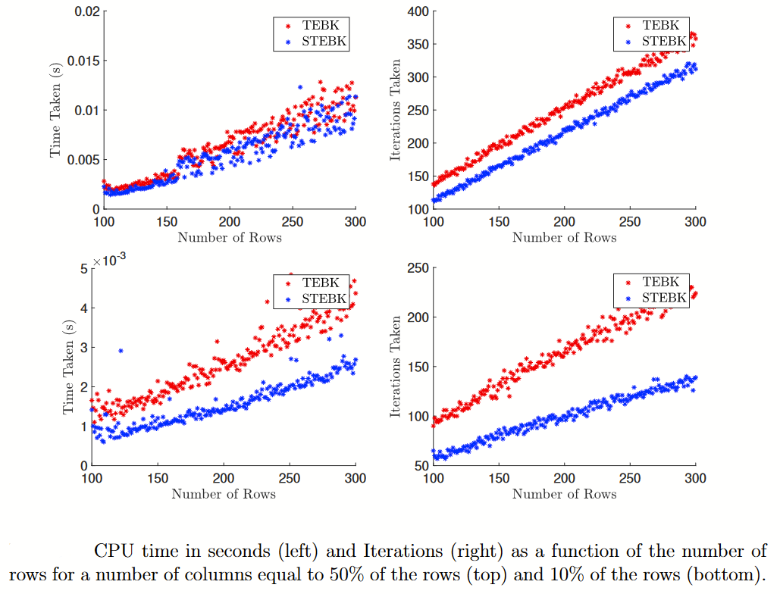

Slide 18
Stepsize
Stepsize aka Relaxation Parameter aka Alpha
Projection equation and Average Block give the direction of motion, but that vector can be scaled
This can be progressively relaxed to solve inconsistent systems
Optimizing the stepsize can give significant decreases to convergence time

Slide 19
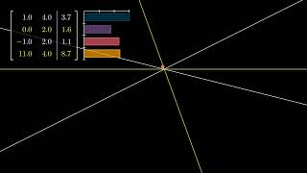

Slide 20
Adaptive Stepsizes
We investigated the Minimum Residual Step Method (MRSM) created by Dr. Platte, which tries to optimize stepsize by doing a greedy residual minimization for the selected block.
Inspired by this, we developed a proof of concept the optimized a constant alpha over the course of convergence, which we referred to as Adaptive Global Alpha.
This inspired us to develop an extension of MRSM, referred to as MultiAlpha.

Slide 21
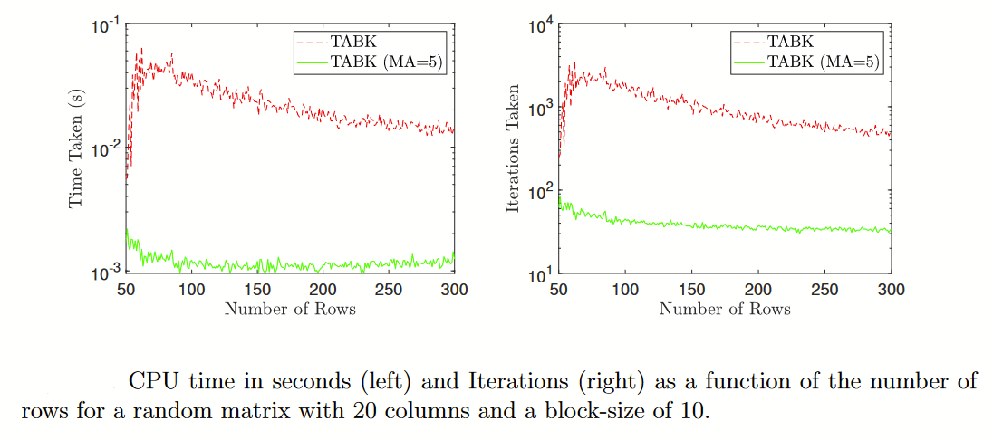
Note: MA refers to MultiAlpha. MA = 5 is a MultiAlpha of “Level” 5. MA=1 is RMSM

Slide 22
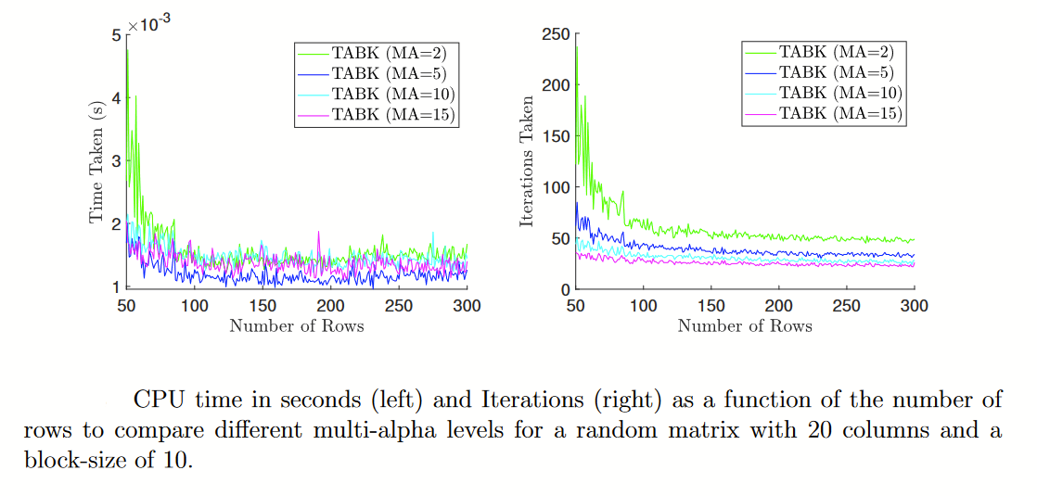

Slide 23
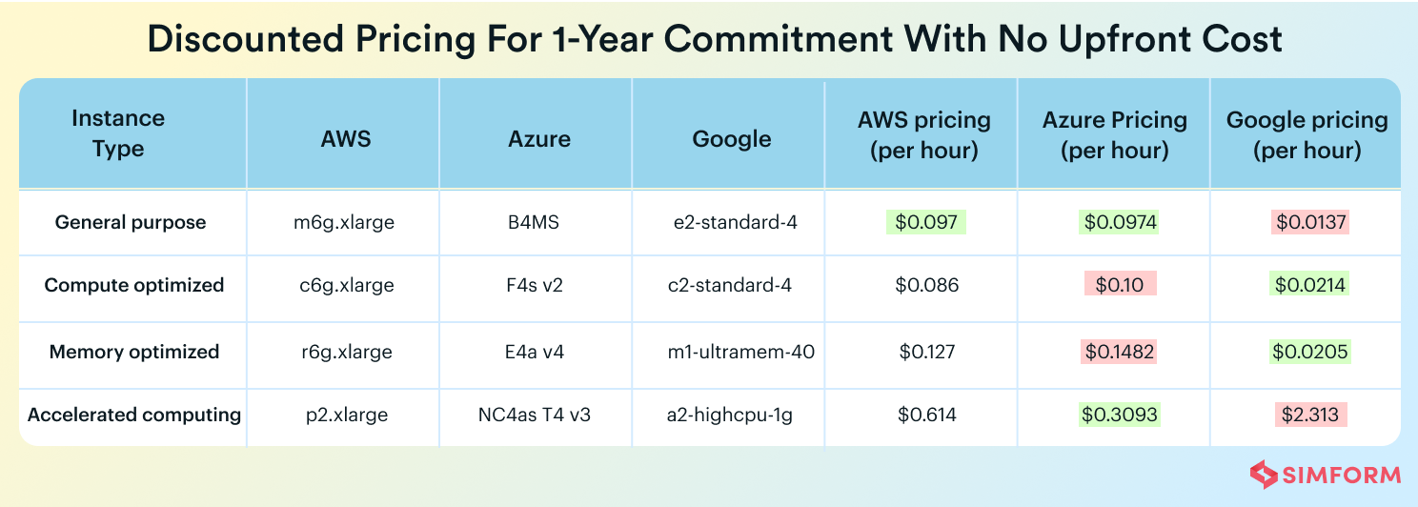
Preconditioning Overview
The right preconditioner can reduce the compute time and number of iterations to convergence
Preconditioning can be a computationally intensive task itself
Breakdown:
Preconditioning on original matrix
Kaczmarz to find solution

Slide 24
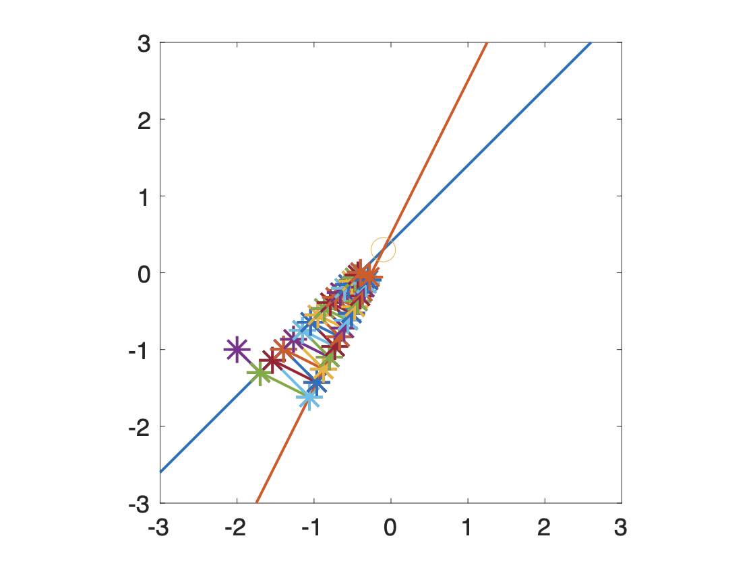
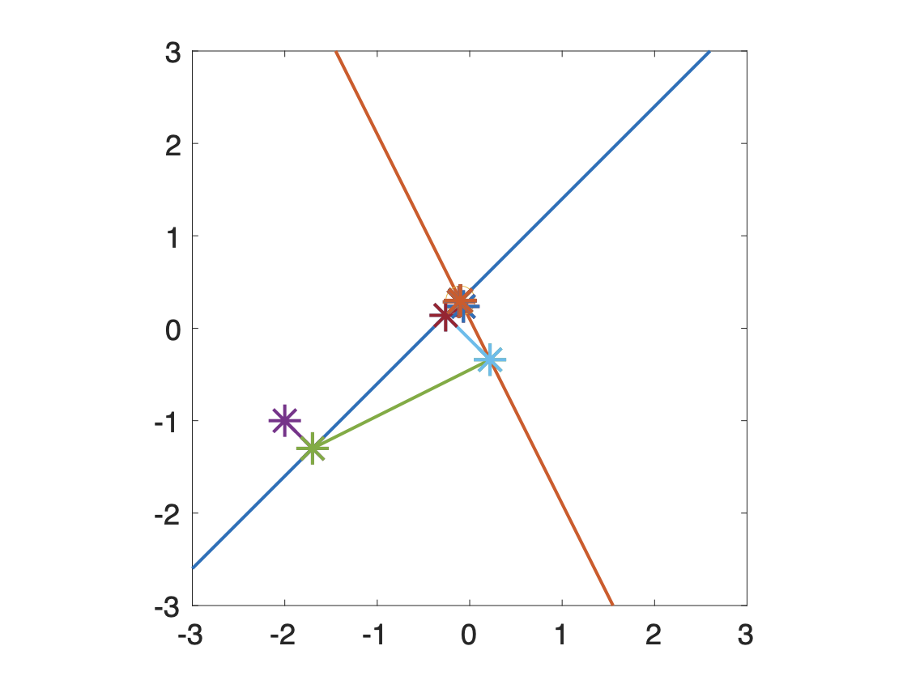
Ill vs. Well Conditioned
Ill Conditioned Matrix
Well Conditioned Matrix

Slide 25
Algebraic Multigrid
Fast and scalable (parallelizable to O(N) computational complexity)
Hierarchical levels are evaluated independently so algebraic multigrid can be parallelized
Sensitive to matrix structure
The Python library PyAMG was used to build the AMG preconditioners
classical_kaczmarz(precond_A_dense, precond_b, x0, max_iter=1000000, max_time=100, log_interval=100)

Slide 26
Sparse Matrices
Sparse systems have a large number of zero elements in the coefficient matrix
Traditional direct methods like Gaussian elimination can be computationally expensive for sparse systems
Applications:
Image and signal processing – denoising, deblurring, image reconstruction
Tomography (CT scans, etc) - Tomographic reconstruction algorithms
Computer graphics - Sparse systems often arise due to complex scene geometry
Network analysis - Solving linear systems arising from large-scale networks

Slide 27
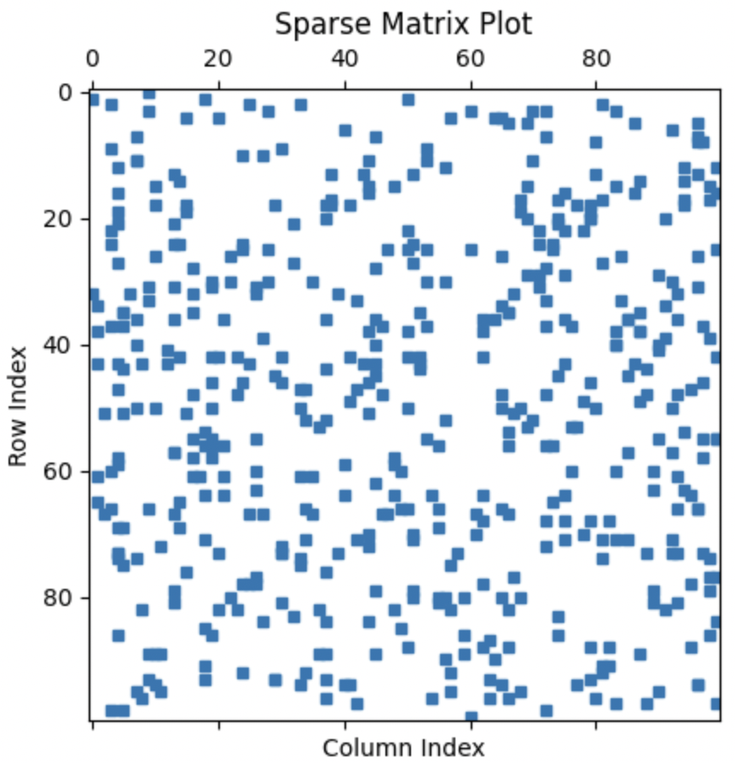
Random Sparse Matrices
 | Original Matrix | Preconditioned Matrix
Condition Number | 477.04150150491705 | 4.886788582228487e+23
Time to Convergence | n/a | n/a

Slide 28
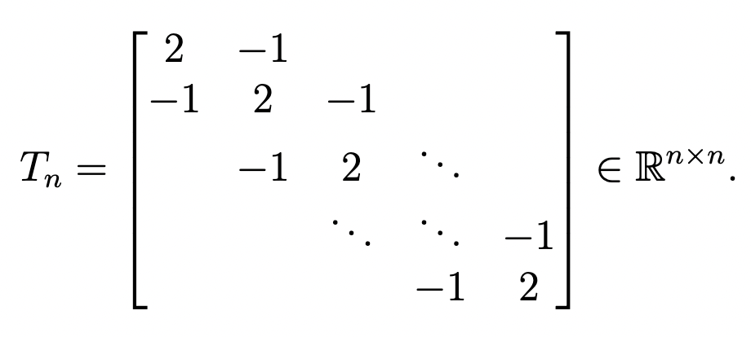
Tridiagonal Matrices
 | Original Matrix | Preconditioned Matrix
Condition Number | 4133.642926801445 | 1.140350162991351
Time to Convergence | 100 s (did not converge) | 0.17116546630859375 s

Slide 29
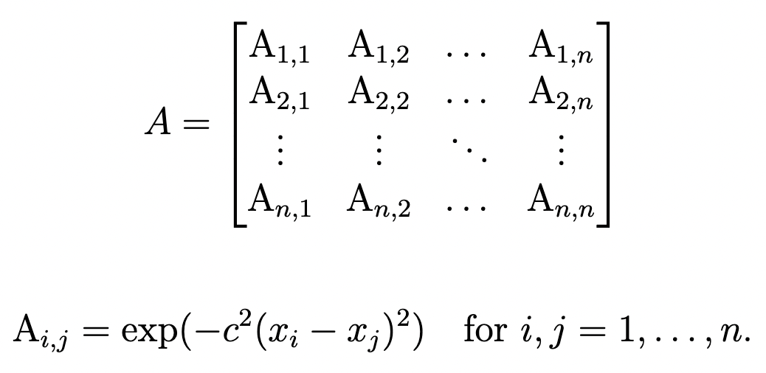
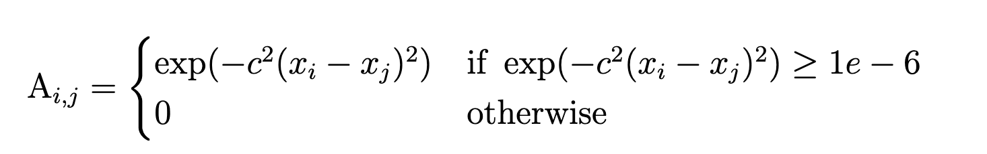
Gaussian Random Matrices
 | Original Matrix | Preconditioned Matrix
Condition Number | 409,317,059.7393808 | 50,692,666.40654751
Time to Convergence | 84.61563634872437 s | 81.48864030838013 s

Slide 30
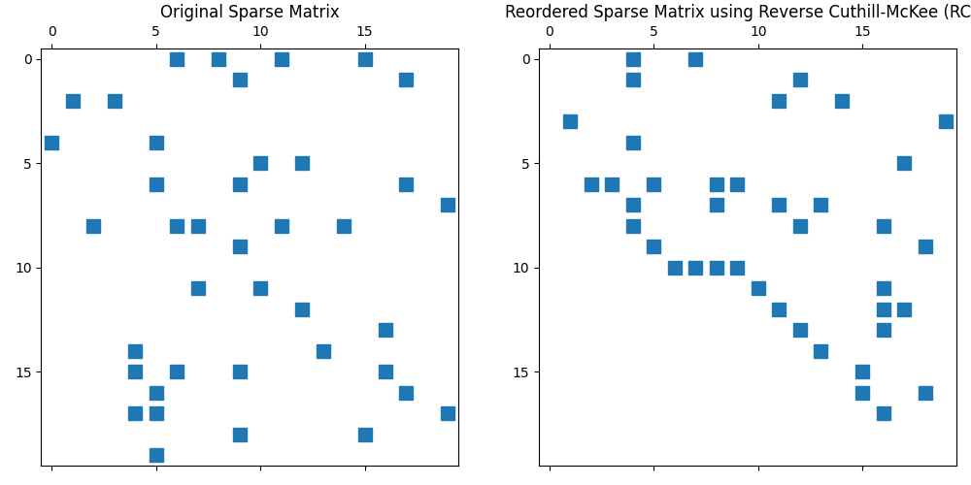
Increasing Diagonalization
Reverse Cuthill-Mckee: Row permutation method to increase diagonalization
 | Original Matrix | Preconditioned Matrix | Preconditioned Diagonalized Matrix
Condition Number | 409,317,059.7393808 | 50,692,666.40654751 | 46,966,193.042337604
Time to Convergence | 84.61563634872437 s | 81.48864030838013 s | 85.09954309463501

Slide 31
Results: Summary
Algebraic multigrid preconditioning may reduce the time to convergence of Kaczmarz if the matrix structure is correct
A matrix may be transformed to be better structured for algebraic multigrid but this transformation may/may not decrease time to convergence
Future Exploration:
Try and fine tune parameters of algebraic multigrid to work with more types of matrices
Compare algebraic multigrid preconditioning to other preconditioners

Slide 32
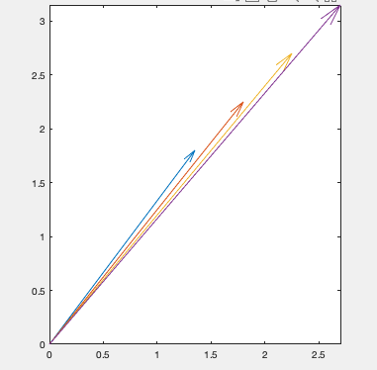
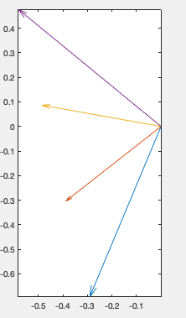
Sketching + QR Decomposition: Background
The sketching method attempts to compress matrix A into smaller more manageable matrix to be preconditioned.
The cost of preconditioning the entire matrix A is computationally expensive.
Consists of QR decomposition and the inversion of the upper triangular matrix R
Total complexity of O(mn^2) + O(n^3)
Problematic when m is significantly larger than n.

Slide 33
Preconditioning in Python: Goals
After replicating results found in research paper Preconditioning Kaczmarz Method By Sketching by Alexandr Katrutsa and Ivan Oseledets:
Apply the preconditioning method to sparse matrices
Investigate an optimal gamma by expanding the size of the matrix and increasing gamma range
Apply the preconditioning method to alternative versions of the Kaczmarz method, specifically randomized average block Kaczmarz.

Slide 34
Algorithm Description: Pseudocode
Pseudocode:
Code iterates over a range of user selected scalar values (gamma) and generates random submatrices from a larger matrix A
Performs a QR decomposition on each submatrix,
Computes the inverse of the resulting upper triangular matrix
Stores results in the variable P
Records the preprocessing time for each gamma value.
Variable P is then applied to the Kaczmarz method via matrix multiplication

Slide 35
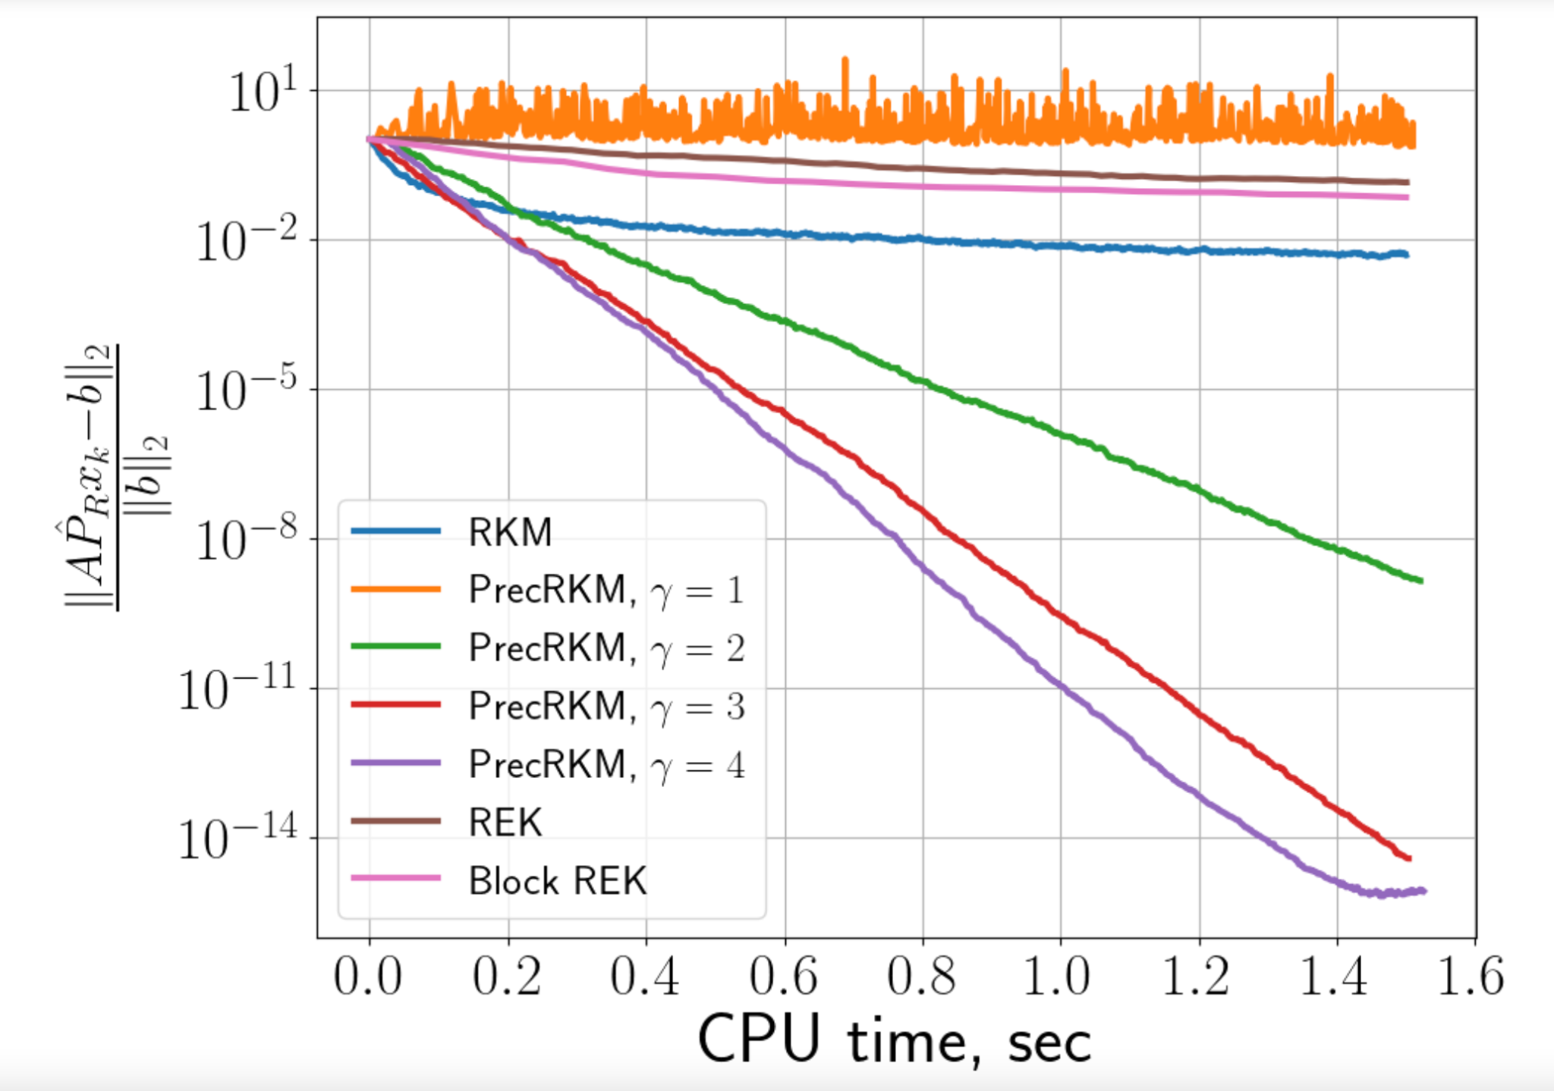
Replicated Results: Relative error vs. running time + time to construct precond.
Relative error: Difference between the estimated or predicted convergence time and the actual convergence time
Expressed as a percentage or ratio
It is used to quantify the accuracy of convergence time predictions in various iterative algorithms

Slide 36
Replicated Results: Relative error vs. running time + time to construct precond.
Notable Behavior:
gamma = 1
Worse than RKM alone
gamma = 2
Begin to see benefits
gamma = 3
Significant benefits
gamma = 4
Diminishing returns
May not be worth the loss of precision

Slide 37
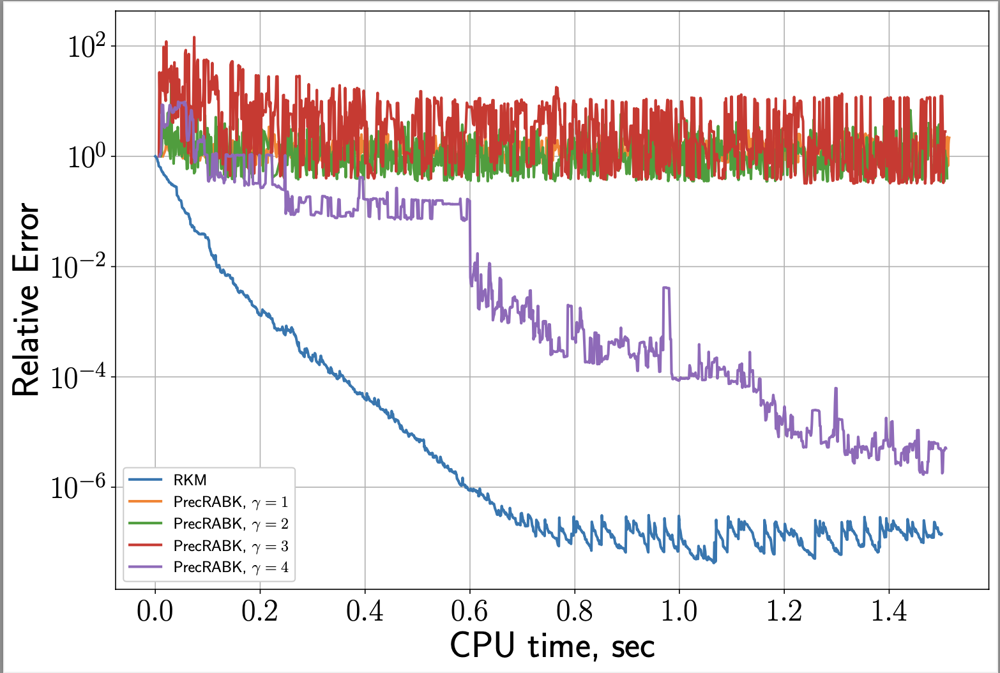
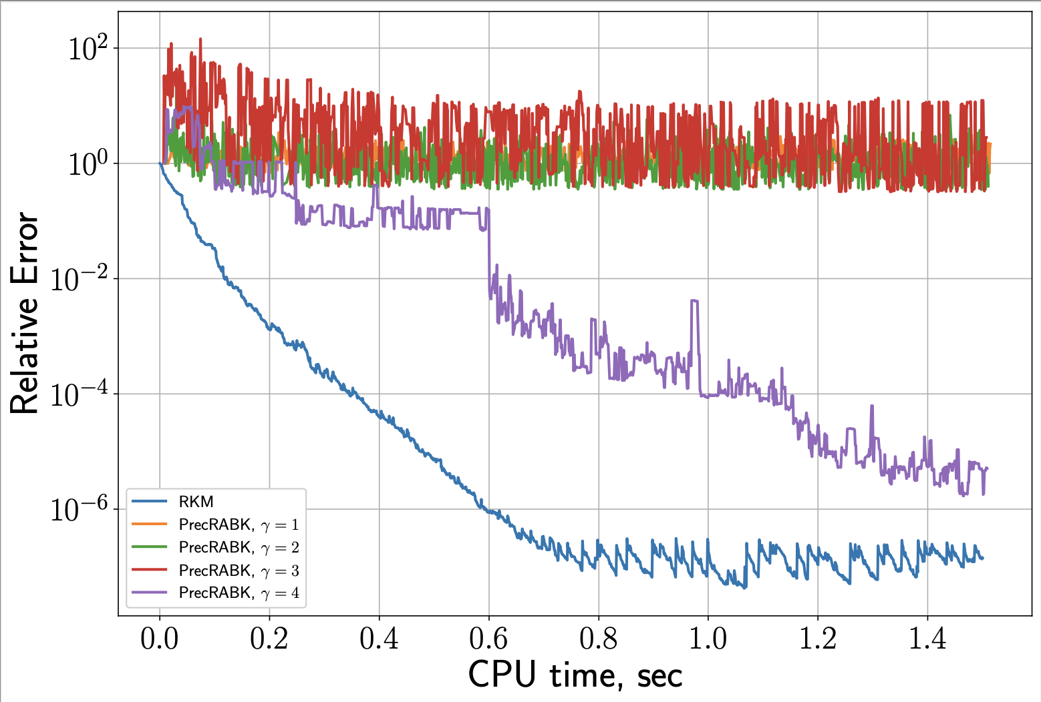
Preconditioned Kaczmarz: Sparse Matrix
Sparse Matrix
Density of 1%
Preconditioning method begins to break down in effectiveness

Slide 38
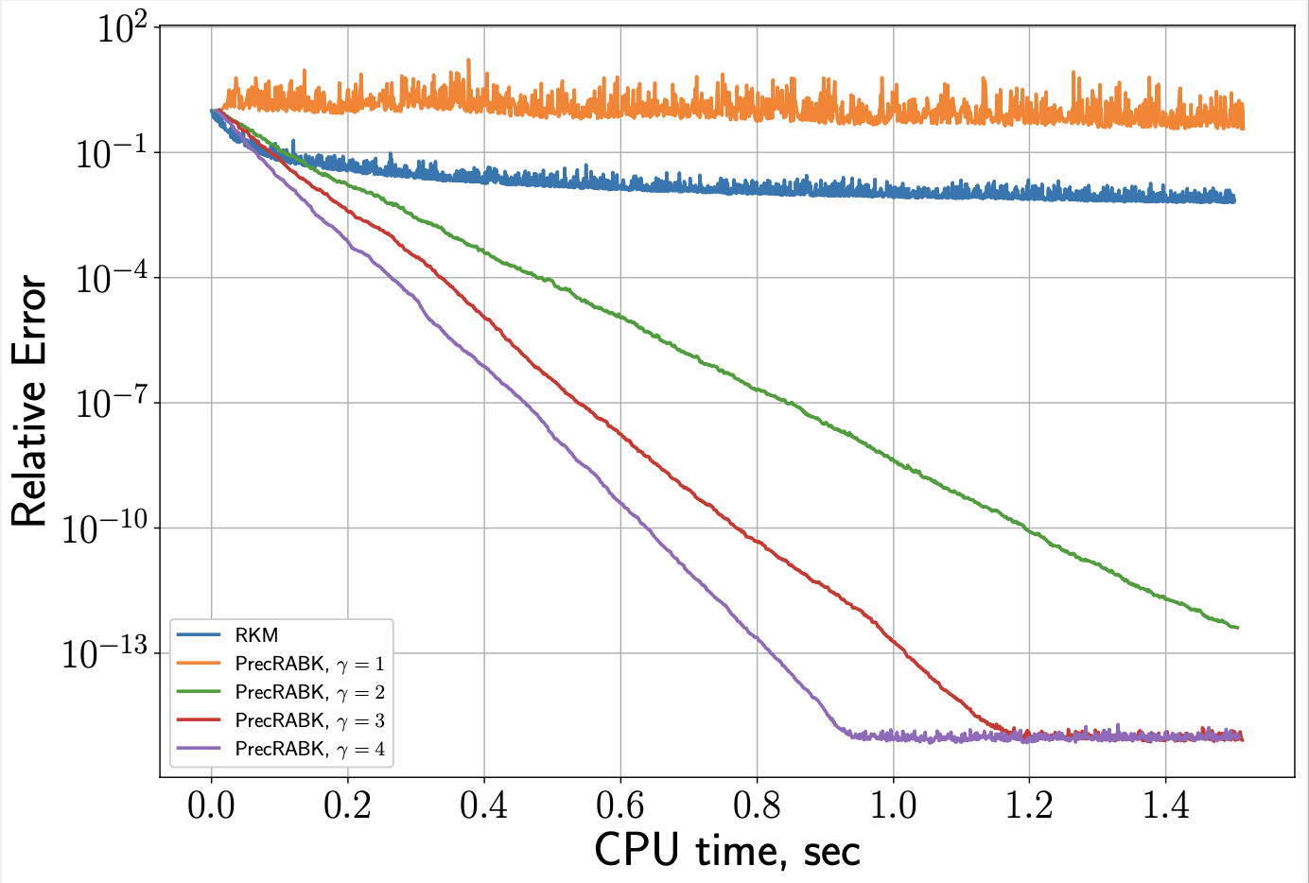
Preconditioned Kaczmarz: Sparse Matrix
Sparse Matrix
Density of 10%
Preconditioning method demonstrates clear improvements to convergence speed

Slide 39
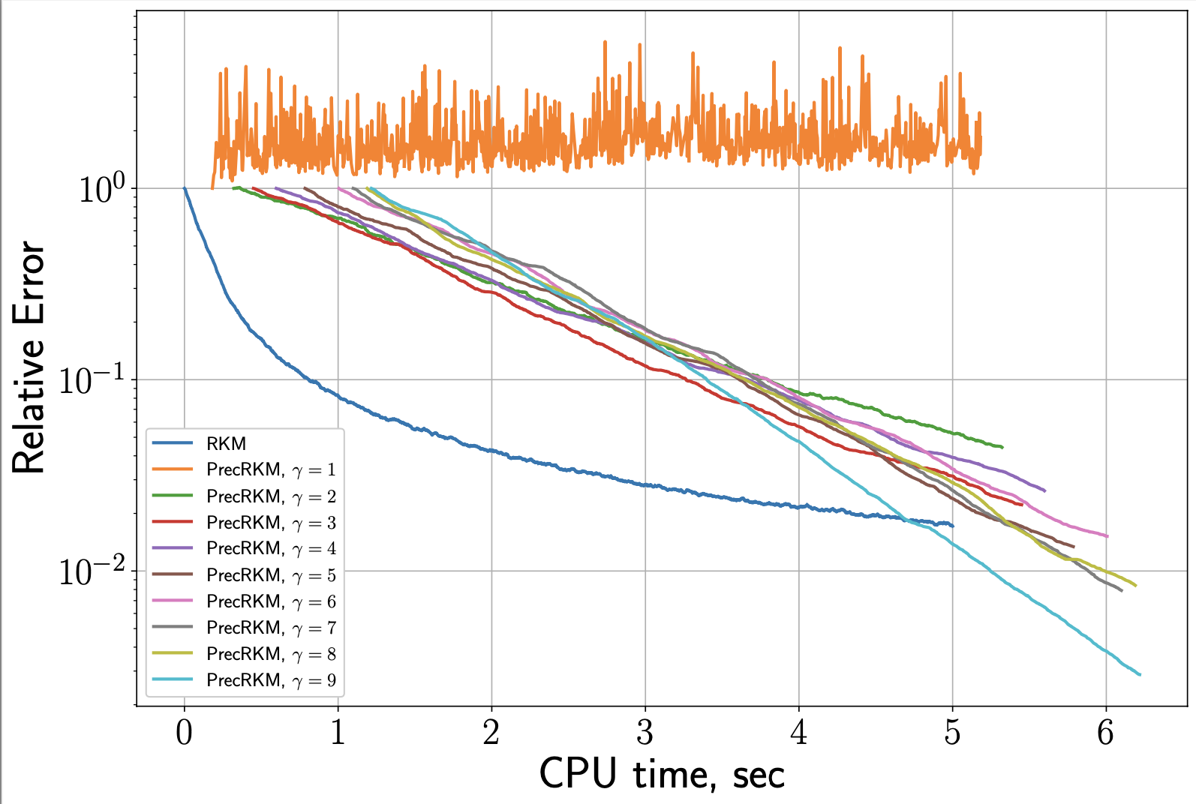
Preconditioned Kaczmarz: Expanded Size + Increased Gamma range
Matrix:
Size: 100,000 by 1000
Gamma Range: 1-9
Begin to see computational expense of QR decomposition
Start-gap

Slide 40
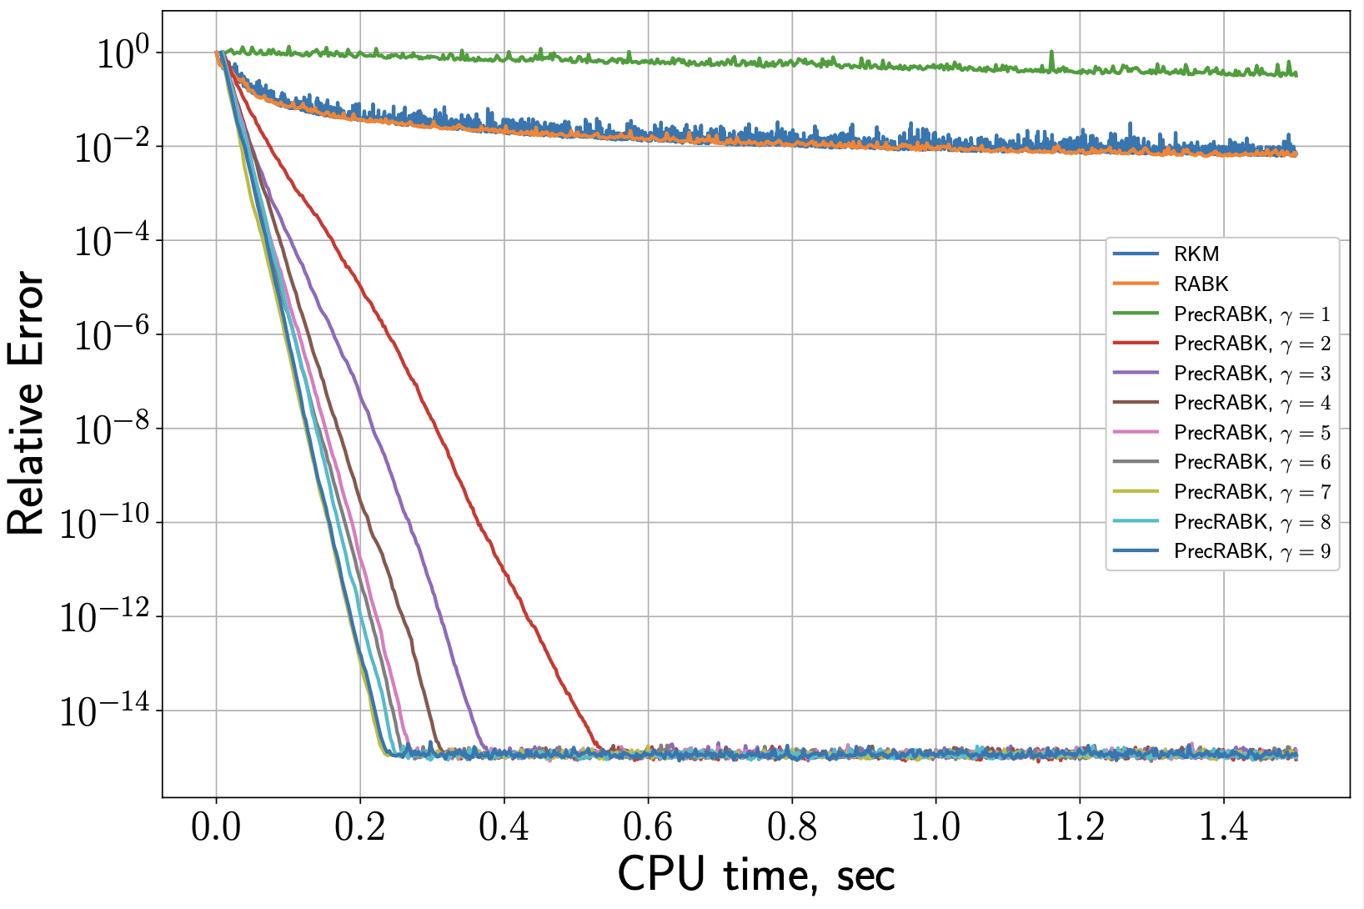
Preconditioned Randomized Average Block Kaczmarz (RABK)
Matrix:
Size: 10,000 by 100
Gamma Range: 1-9
Significant improvement in efficiency
Gamma range 5-7
Benefits begin to diminish

Slide 41
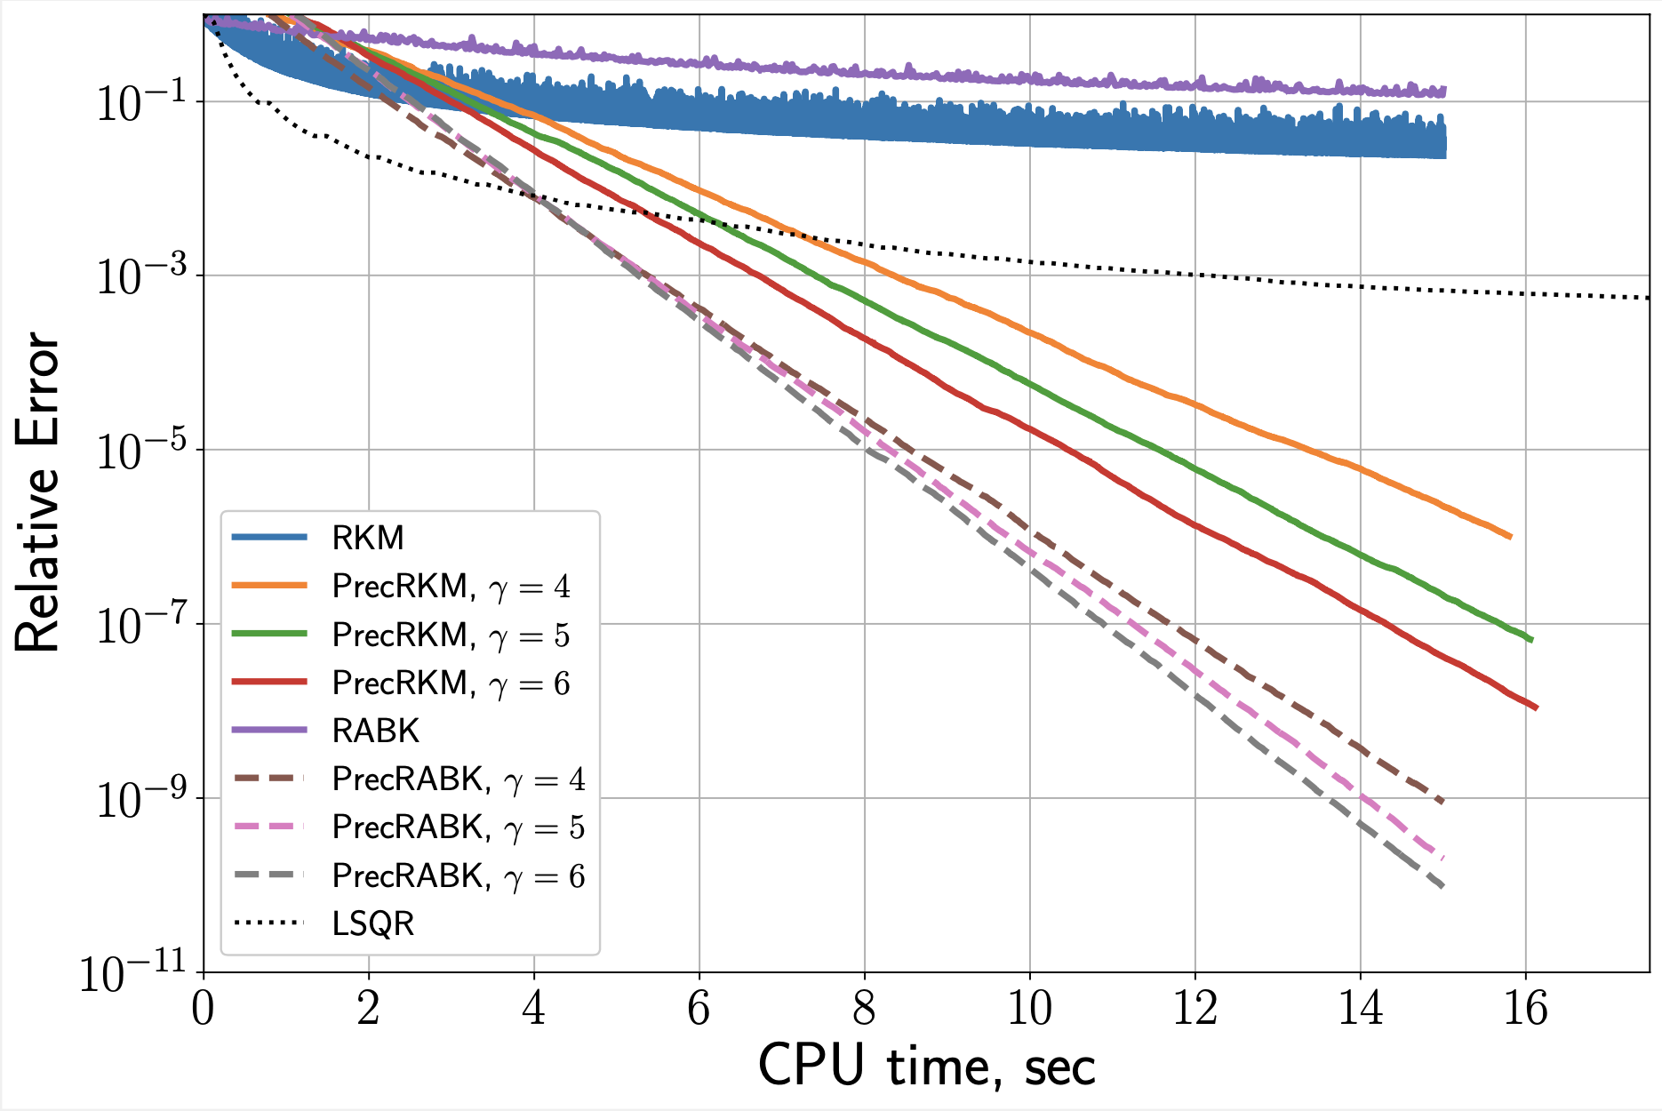
Preconditioned Kaczmarz: Iterative Method Comparison
Matrix: 100,000 by 1000
RKM
PrecRKM
RABK
PrecRABK
LSQR

Slide 42
Results: Summary
Driving goal: Explore the instances where preconditioning by sketching was beneficial, investigate the limitations, and improve upon the method.
Favorable results:
Consistent systems
m >> n
Unfavorable results:
Extremely sparse systems - density of 1%
Gamma of 1
Large datasets (unless alternative Kaczmarz method is used)

Slide 43
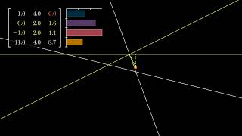

Slide 44
Corrupted Data
System may have corrupted RHS entries
Corrupted rows shift the hyperplanes away from the solution
If included in iterations, it can prevent convergence
Need a way to detect and exclude corrupted data from algorithm, if the level of corruption is not too large, the solution can still be recovered
c represents some corruption that affects the RHS that it much more significant than noise

Slide 45
Quantile Row Selection
If a row has a high residual entry, it is an indication that it is likely corrupted. So, this method takes the top quantile of absolute residuals and excludes them from iterations. After that, the algorithm proceeds as normal.
Beta represents the level of corruption in the system, q should be picked so that it plus beta doesn’t exceed 1
This times the number of rows in the system will be the number of lowest residuals that pass the quantile test

Slide 46
Sampled Quantile Row Selection
A sample of the rows of the system can be taken to save CPU Time. This version takes a percentage of the rows and computes the quantile of that sample before iteration.

Slide 47
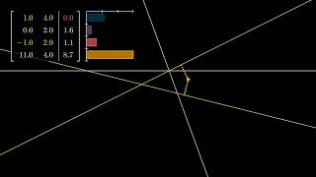

Slide 48
Experiment
Each method was used to solve randomly generated, overdetermined, consistent systems with a percentage of corrupted RHS entries
Entries were corrupted by setting them to 0
Average CPU Time and Iterations taken vs. Number of rows
Block size for QABK was block size for SQABK for a given number of rows
q = 0.85, beta = 0.1, 100 columns, relative tolerance 10^(-10), max iterations 40000

Slide 49
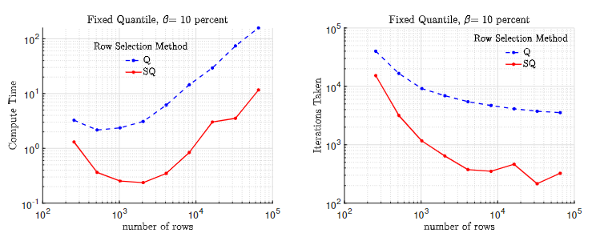

Slide 50
Adaptive Quantile and Experiment
Precise estimate for corruption level may not be known
Underestimation can prevent convergence, overestimation can slow it down
The adaptive version will check the norm of the residual as a heuristic
If the norm is significantly larger than the previous iteration, the quantile is lowered and the iteration is skipped, if it is significantly smaller, the quantile is raised (the thresholds have been arbitrarily decided)
Adaptive version and regular version were tested on a random 100 x 10 system with beta = 0.2, and q = 0.9 to start
Relative error vs. CPU time and iterations

Slide 51


Slide 52
Questions?

